Slide 1
Beyond Undiagnosed
By DONS
June 2019

Slide 2
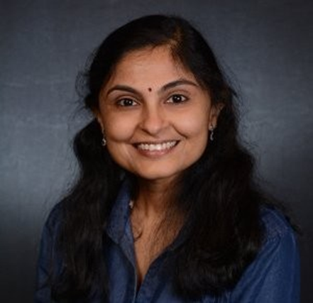
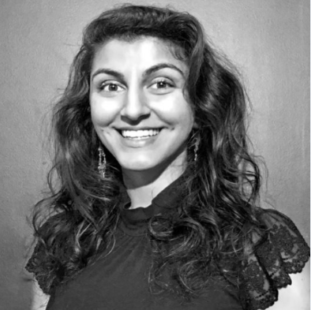
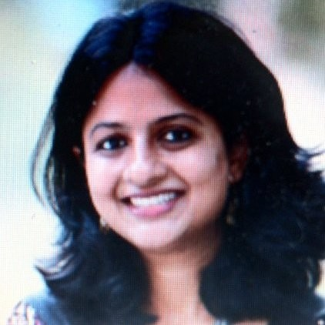


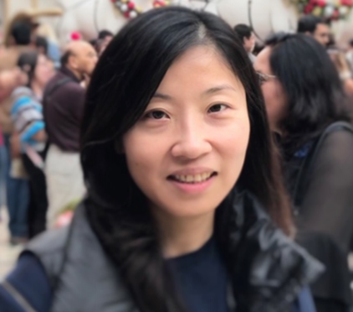
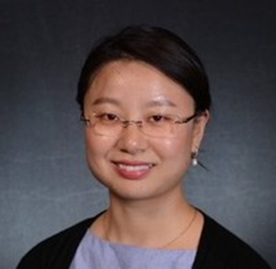
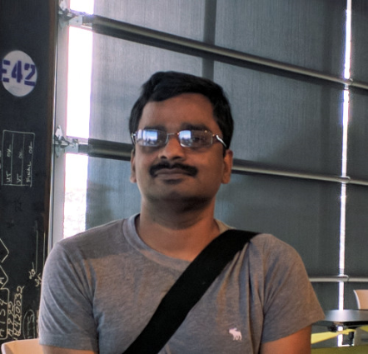

DONS Team
Advice From:
Lakshmi Arbatti, MS,
Grey Matter Technologies
Chief Data Scientist
Prof. Patricia Francis-Lyon
Assistant Professor
University of San Francisco
Vaishali Chaudhuri,PhD, AstraZeneca
Data Scientist
Monica Javidnia,
PhD,
University of Rochester
Jerome Bouquet
Microbiome scientist
AstraZeneca
Xiangyi Xu, MS,
Sutter Health
Statistical Analyst
Xiaoyun Cheng, PhD
Genentech
Data Science Intern
Dmytro Lituiev
UCSF, PostDoc
Applied MachineLlearning Researcher
Anil Kemisetti, MS, UCSF
Bioinformatics Programer
Dr. Saloni Sharma, MBBS
Medical Researcher
Strong memorial Hospital , Rochester

Slide 3
Goals
Help John identify causes.
Identify possible causes to benefit more people who may be in similar situations.
Set up workflow replicable.

Slide 4
Hypotheses
Recurrent themes that we observed in his symptoms point to:
1) brain stem area related dysfunction (nausea, difficulty regulating temperature, delayed gastric emptying, vomiting, sweating etc),
2) probable collagen disorder,
3) probable lysosomal storage disease

Slide 5
Workflow
As a preparation, fathom medical records, gather physicians and biologists’ thoughts, run testing by using IGV (Integrative Genomics Viewer) and CRAVAT VEST-4 (Variant Effect Scoring Tool),CHASM-3.1.
Listen to John to collect first-hand patient experience, symptoms, and reaction to medications to formulate thoughts.
2-way in parallel:
Further extract and filter medical records to gather key symptoms and diagnosis.
Use Ingenuity Variant Analysis to find suspicious causes based on patient’s symptoms sharing.

Slide 6

Talking to John . What did we know : (Part 1)
Gastrointestinal
Would vomit up breast milk as a child. Switched to soy formula.
Dexamethasone helped with appetite, but experienced negative side effects at higher doses
Primarily eats processed foods (e.g., cup of noodles) and as a child, preferred liquids (e.g., broth)
Chronic use of laxatives due to gastroparesis/low gut motility
Slow reacidification of the stomach
Uvula suturing helped with vomiting and nausea, but uvula is still swollen, red
MCT and coconut oil lead to abdominal pains and constipation
Major abdominal distention and pain following meals

Slide 7
Talking to John . What did we know : (Part 2)
Sleep, vision, olfaction, and hearing are normal
Sleep disturbed due to urinary frequency. Also experiences urinary hesitancy and can take 20 minutes to initiate flow. No sexual dysfunction.
Muscle levels are okay, but low body fat is primary concern (major back injury due to low weight)
Fatigues quickly and easily; takes stimulants (e.g., coffee) to counter fatigue
HPV vaccine helped with warts on hands; previously had them frozen off

Slide 8
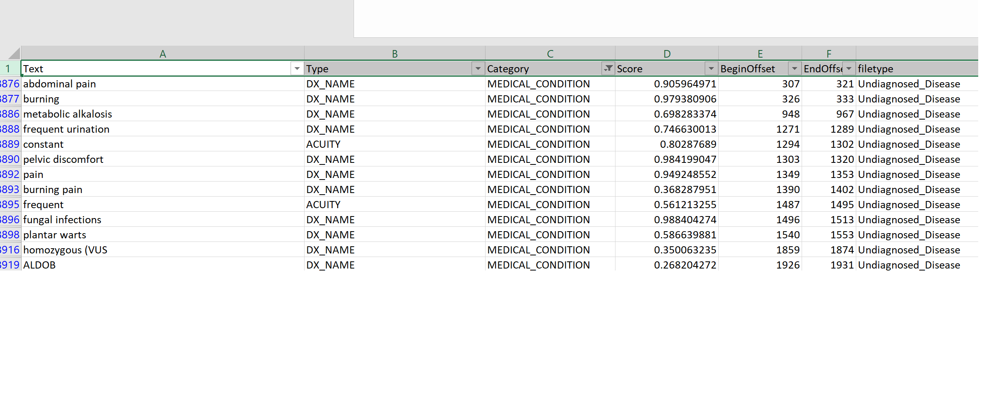
Symptoms extracted from medical notes using AWS Textract

Slide 9
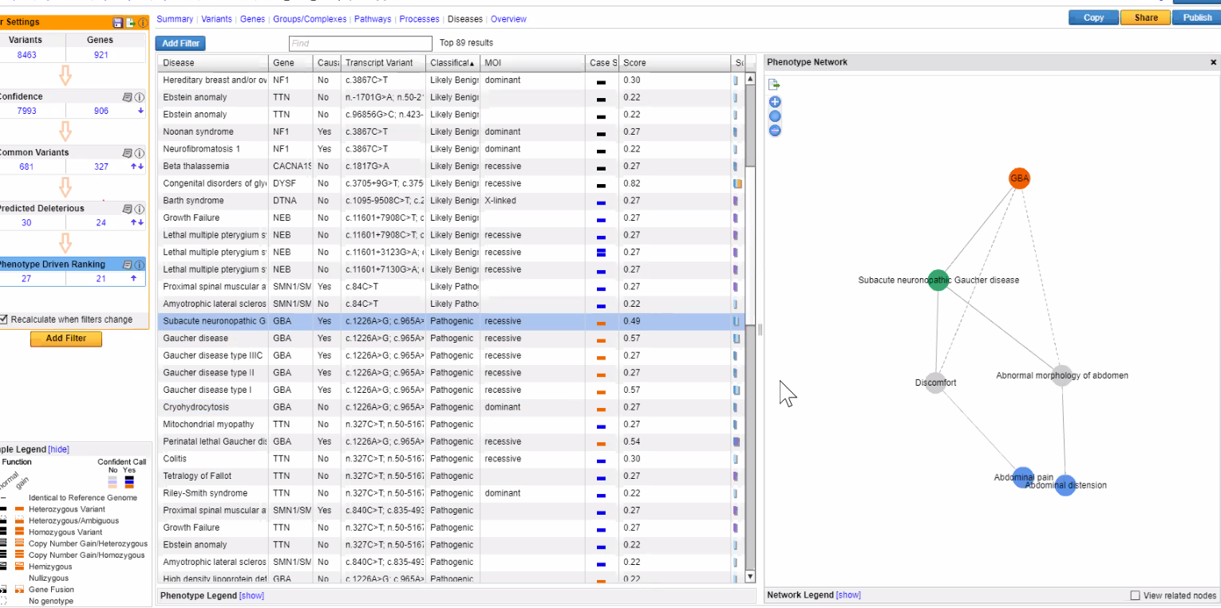
Phenotype Driven Analysis (QIAGEN-IVA)
Panel:
Cardial-neural
Filters:
Abdominal distension
Abdominal pain
Weight and growth Stagnation
Hyperhidrosis

Slide 10

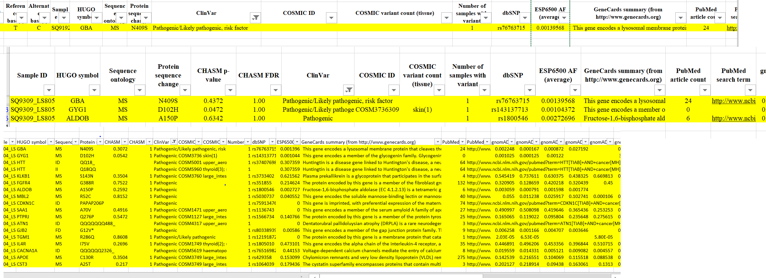
CRAVAT

Slide 11
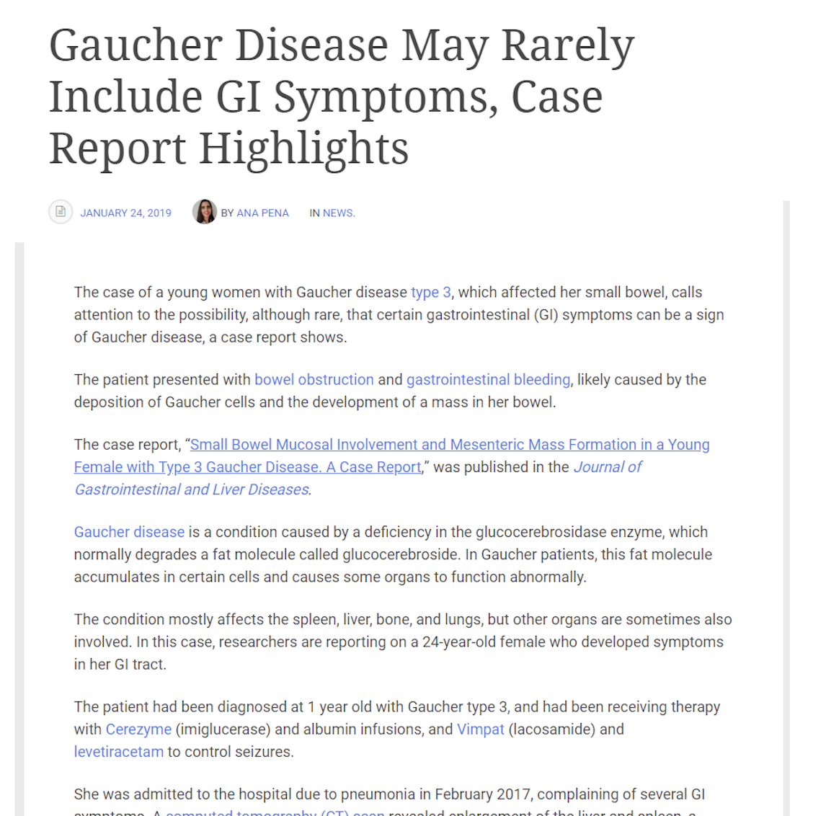
Correlation with Medical Literature-1

Slide 12
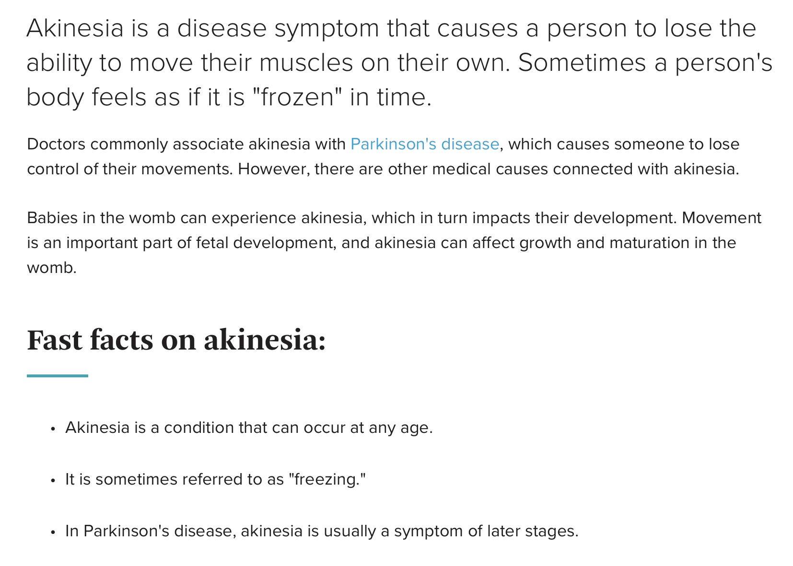
Correlation with Medical Literature-2

Slide 13
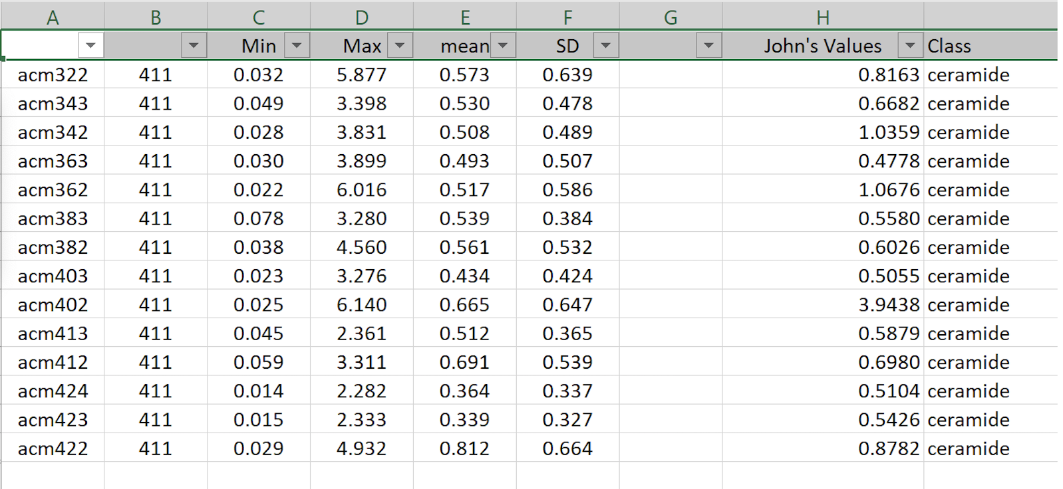
Correlation with patient metabolite levels
”The lysosomal enzyme glucocerebrosidase, encoded by the glucocerebrosidase gene, is involved in the breakdown of glucocerebroside into glucose and ceramide. ”
Siebert M, Sidransky E, Westbroek W. Glucocerebrosidase is shaking up the synucleinopathies. Brain. 2014 Feb 14;137(5):1304-22.

Slide 14
Next Steps…
A blood test is used to make the diagnosis of Gaucher disease.
The enzyme assay test measures the activity of the glucocerebrosidase enzyme in certain white blood cells. Having less than 15% of normal enzyme activity is diagnostic for Gaucher disease. Genetic analysis is also done to establish the specific type of mutations in the GBA1 gene.
Other medications
drugs that block the production of the sphingolipids that accumulate in cells and cause symptoms. These drugs are known as glucosylceramide synthase inhibitors and are taken by mouth. Two drugs in this class are miglustat (Zavesca) and eliglustat (Cerdelga).

Slide 15
Acknowledgement
John “JCM”
SVAI

Slide 16
Thank You!

